Slide 1
INVESTMENT CASE STUDY SUBMISSION
Group Name:
Pratima Patel
Vivek Reddy
Roshan
Krishna Mirajkar

Slide 2
Data Cleaning
Loaded Companies and Rounds2 data into python for processing and cleaning the data by removing special characters for columns permalink and company permalink and converting names

Slide 3
<Analysis>
Unique companies in rounds2 & Companies 66368

Slide 4
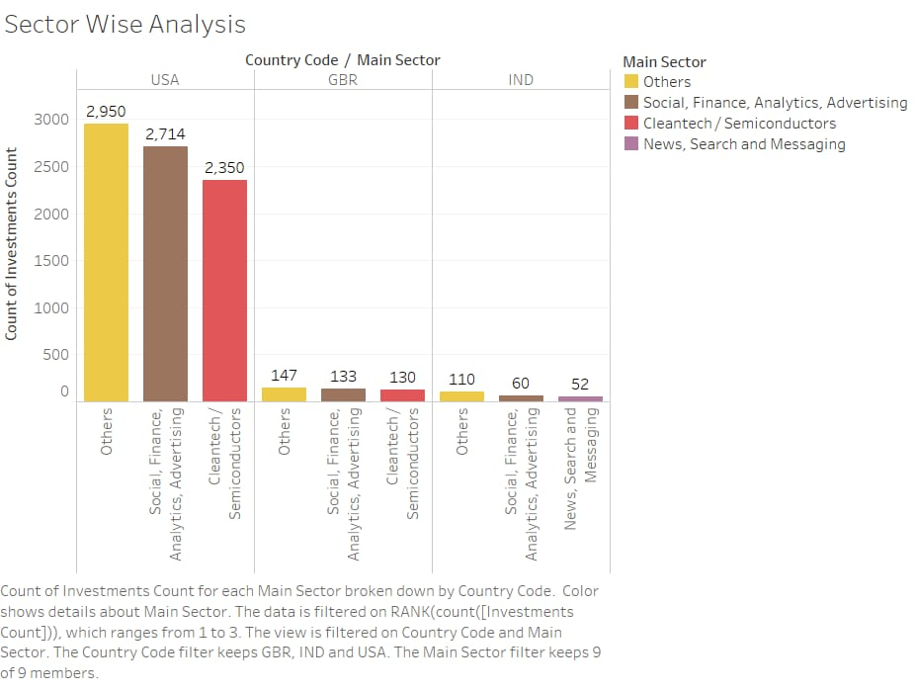
<Results>
Plot 1

Slide 5
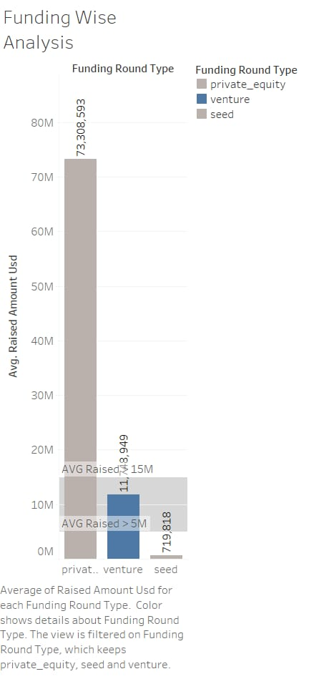
<Results>
Plot 2

Slide 6
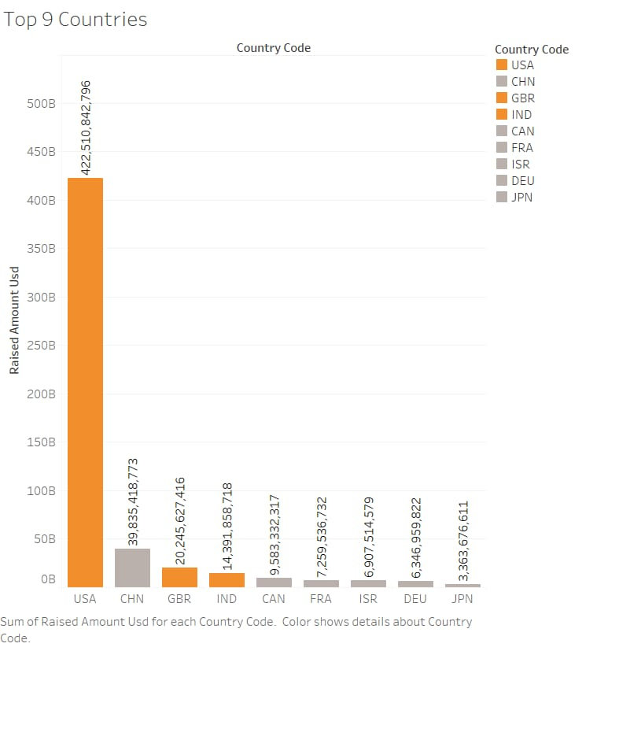
<Results>
Plot 3

Slide 7
<Conclusions>
Based on investments made in venture, angel, seed, private funding rounds type,
### most preferred investment is made in Venture funding type which has ~11.75 Million USD investments made
### Answer: Venture
#1. Top English-speaking country: USA
#2. Second English-speaking country: GBR
#3. Third English-speaking country: IND
## Total Number of investments in USA : 12149
## Total Number of investments in GBR : 628
## Total Number of investments in IND : 330
# Total amount invested in USA: 108521860586.0
# Total amount invested in GBR: 5436843539.0
# Total amount invested in IND: 2976543602.0
Top Sector : Other
Second best : Social, Finance, Analytics, Advertising
Third Best : Cleantech / Semiconductors & News, Search and Messaging

